Slide 1
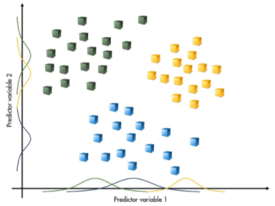
Naïve Bayes Classifier

Slide 2
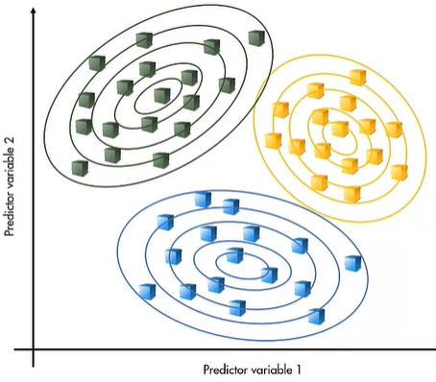
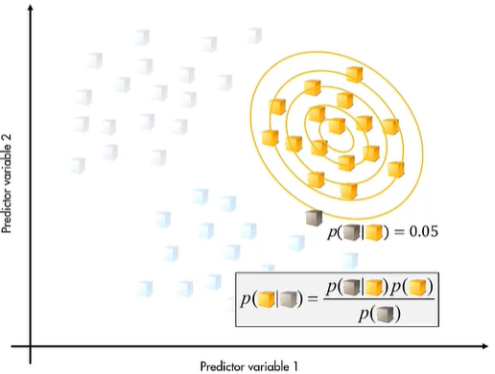
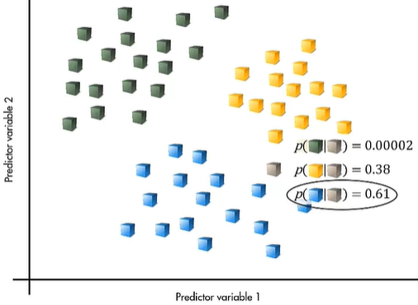
What is Naïve Bayes Classifier?
Naïve Bayes classification works by assuming that the observations in each response class are samples from probability distributions– a separate distribution for each class
If the probability distribution is known, it is possible to calculate the probability of a new observation occurring at its given location under the assumption that it belongs to a particular class
Bayes’ theorem of conditional probabilities gives a way to calculate the probability that the observation comes from the given class
It is possible to calculate this probability for each class and classify the observation according to which class is the most likely
Notes:
Introduction to Naive Bayes Classifier

Slide 3
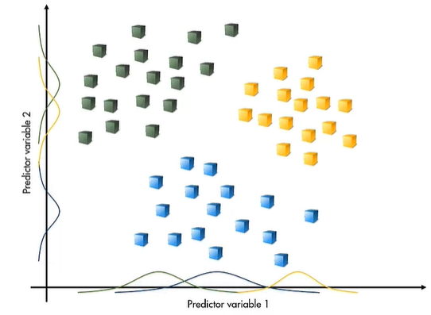
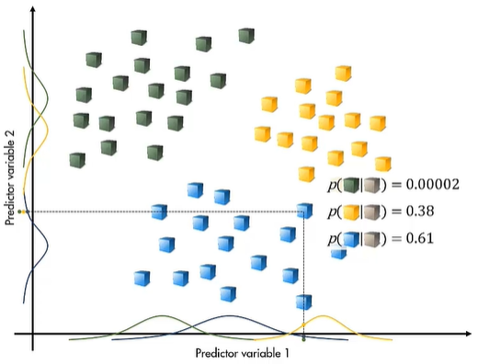
Naïve Bayes Classification
The naïve assumption is that each variable is independent in each response class
Fitting a normal distribution in each variable independently involves simply calculating the mean and standard deviation for each combination of class and variable
Performing predictions requires determining the probability of the observation and applying the formula from Bayes’ theorem
Since the distributions are independent in each predictor, the probability is the product of the probabilities in each variable
The predictions are based on the statistical distribution of all the observations, rather than individual observations:
robustness to noise in training data
Notes:
Bayes’ theorem of conditional probabilities is applied to classify a new observation.
The assumption that each variable is independent in each response class is used during the classification.

